Slide 1
INT305 – Week 5
BEAR Application Presentation
Belinda Garcia
Professor: Joseph Issa
February 3, 2021
Notes:
Hello Class, Here is my Application presentation for this week’s assignment. Although I could not complete the code to show you the application in real-time I want to go over with you the design and functionality that I was hoping to obtain.

Slide 2
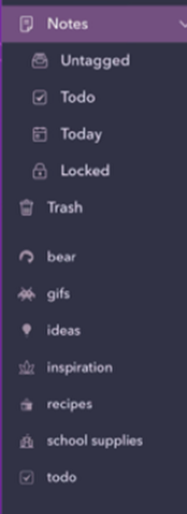
Definition State and Use:
Application will be created to enhance the note and reference applications that are used on iOS devices
As each section of the application is created, it will integrate with the calendar, tasks, or alarms that are created on the device.
Links to websites, pictures, or notes can be categorized in one place.
Notes:
The BEAR application is an application that is created to enhance the note and reference applications that are used on an iOS device. The application is created with the intent to integrate the iOS applications such as calendar, tasks, and reminders, while adding the ability to organize information found in applications such as Pinterest. The ability to link photos that are either imported or stored can also be used as reference to the items that are categorized.

Slide 3
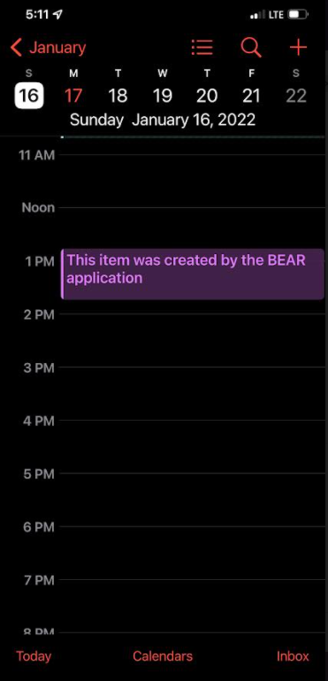
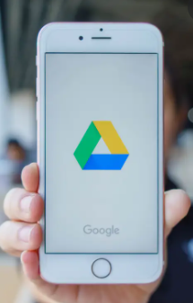

Describing features: Integration
Items created in the application will
Show up in the native calendar of the device
Alarms can be set if needed.
Notes:
The features of the application will use the application user interface to integrate with the native applications in the iOS device. As items are created in the BEAR application they will also appear in the native application. The use of alarms or notifications that are set within the BEAR application will help the user to stay organized and punctual. Each item could be listed on the iOS calendar to potentially use the alarms and notification of the device.

Slide 4
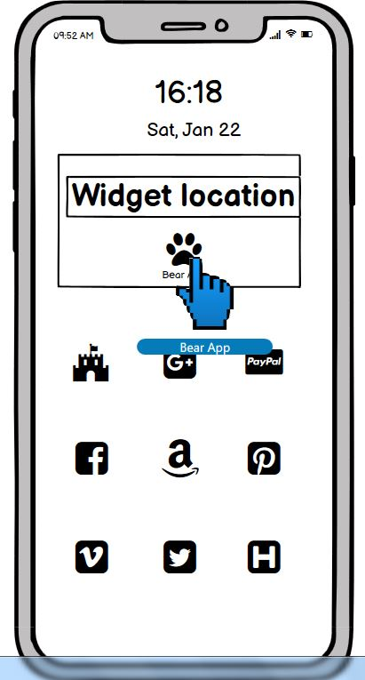
The home screen can
contain a widget that will
show alerts that can quickly
allow for the user to navigate
to the item within the
Application.
Notes:
The device’s home screen can be configured to include a widget that will also provide notifications that could be used to navigate directly to the items in the application. Reminders, alerts, or tasks that have reached their time limit can be displayed as tools to keep the user informed.

Slide 5
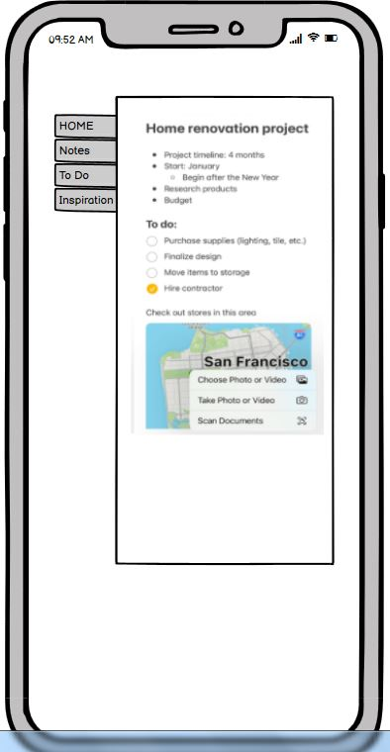
The application can be
configured to label each
section of the information
in order to keep each part
organized.
The notes section could
Link to iOS notes, and the
“To Do” section could link
to the tasks application in
the native applications.
Notes:
Each of the tabs that are found within the application can be configured to label each section of the information. The labeling is used to keep the information organized and provide separation of various topics or tasks.
The notes section is directly linked to the iOS notes, but in this application they could be organized into sections. “To do” items can be linked to the tasks section in the iOS native application.

Slide 6
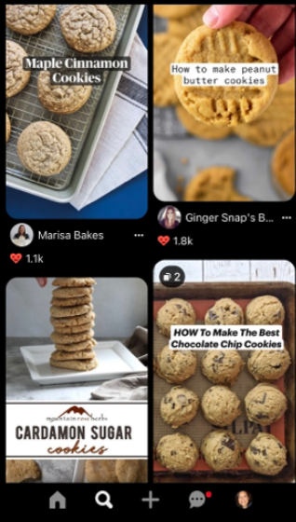

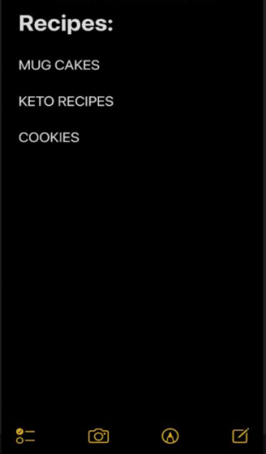
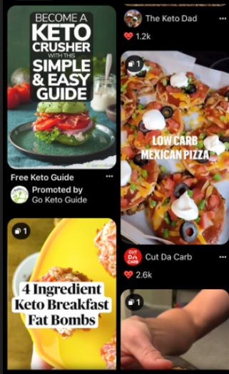
Integration:
As each section is created… they could be linked to particular Pinterest pins.
Notes:
Each section that his created could be linked to the various applications, like Pinterest, that provide information and inspiration. The sections could be created in order to make finding pinned information much easier to find.

Slide 7
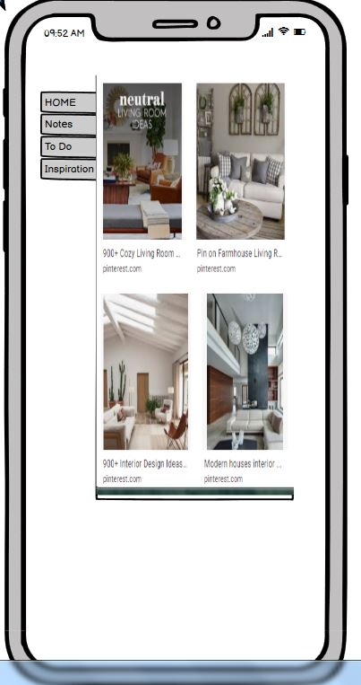
The Inspiration tab
could be used to
integrate the links found
in either Pinterest or stored
pictures that have been
imported or taken.
Depending on how the
application is used, will
depend on how many tabs
will be created.
Notes:
For the Inspiration tab, it could be used in order to integrate the links found in Pinterest or it can link to the stored pictures that have either been imported or taken by the device. As more projects are created, the application can categorize the information into their own distinct tabs so that each of them will stay organized.

Slide 8
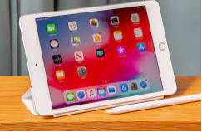
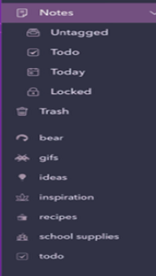


Information available across devices:
Notes:
Due to the use of the iOS cloud, as the application is updated on one of the devices, it will update the other devices that are logged into the same iCloud account. The updates could be done on either device, and each of them will stay updated.

Slide 9
Test and Outcomes:
Testing of the application included the ease of
use and the configuration of the various tabs that
are needed.
Successful outcome is reached when the items that are input are easily found and the integration of the native iOS functions are used with seamless functionality.
Thank you for your time.
Hope you enjoyed my presentation.
Notes:
Although I was not able to successfully complete the coding for the application in the timeframe given, I do believe that it will be something that I will eventually complete. The testing for the application will include the creation of the various tabs and the integration that is needed to store the information in both the created application and the native application of the iOS device. It will be considered a successful outcome when the user interface allows for the use with little to no problems.

